Slide 1
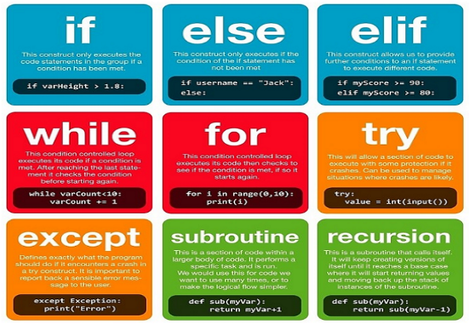
Unit 11.2 - Programming Constructs
Prepared by: Koh Kian Hua

Slide 2
Objectives
After completing this unit, students should be able to:
Use pseudocode to write:
  an ‘IF’ statement including the ‘ELSE’ clause and nested IF statements
  a ‘CASE’ structure
  a ‘count-controlled’ loop:
  a ‘post-condition’ loop
  a ‘pre-condition’ loop
Justify why one loop structure may be better suited to solve a problem than the others.

Slide 3
Programming Constructs
Case and If
In programming, we can use a nested IF statement when there are two different choices to be made.
When there are several different choices to be made, a CASE statement should be used for clarity.
  And a final catch all for an identifier that met none of the conditions given OTHERWISE.

Slide 4
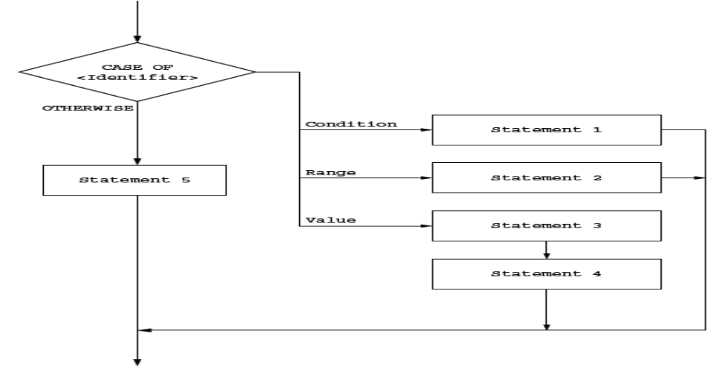
Programming Constructs
Case and If
Flow chart showing how each criterion can have one or many statements to execute.

Slide 5
Programming Constructs
Case and If
Flow chart showing how each criterion can have one or many statements to execute.

Slide 6
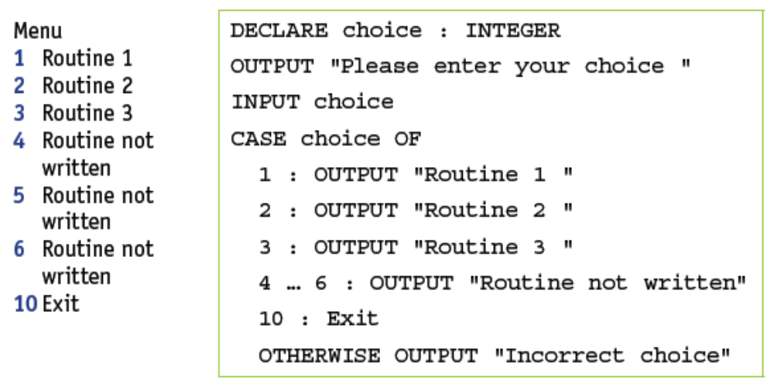
Programming Constructs
Case and If
Choices from a menu can be managed by the use of a CASE statement.

Slide 7
Programming Basics
Case Statements
The table below shows the case statements in VB. Python does not use this construct..
Case statements for menu choices | Programming Languages
Select choice Case 1 Console.Writeline ("Routine 1") Case 2 Console.Writeline ("Routine 2") Case 3 Console.Writeline ("Routine 3") Case 4 Console.Writeline ("Exit") Case Else Console.Writeline ("Incorrect choice") End Select | VB uses Else instead of OTHERWISE

Slide 8
Programming Basics
Case Statements
The table below shows the case statements in Java.
Case statements for menu choices | Programming Languages
switch (choice) { case 1: System.out.println("Routine 1"); break; case 2: System.out.println("Routine 2"); break; case 3: System.out.println("Routine 3"); break; case 4: System.out.println("Routine not written"); break; default: System.out.println("Incorrect choice"); } | Java uses default instead of OTHERWISE and uses break to pass control to the end of the code block when a section is finished.

Slide 9
Programming Constructs
Loops
Loops enable sections of code to be repeated as required. They can be constructed in different ways to meet the requirements of an algorithm.
a count-controlled loop FOR … NEXT
a post-condition loop REPEAT … UNTIL
a pre-condition loop WHILE … DO … ENDWHILE
In order to program efficiently, it is important to select the appropriate loop structure to efficiently solve the problem.

Slide 10
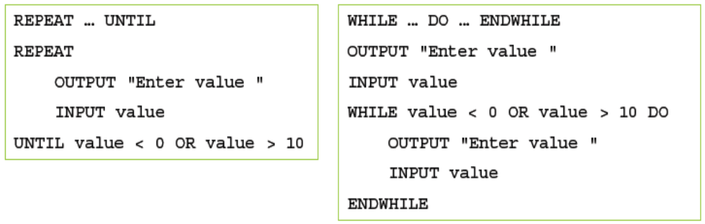
Programming Constructs
Loops
It is better to use a REPEAT … UNTIL loop rather than a WHILE … DO … ENDWHILE loop for a validation check.
The statements inside the loop must always be executed at least once and there is no need for a second input statement.
The example below shows two different kinds of loop that is used to check that a value is between 0 and 10.

Slide 11
Programming Constructs
Loops
The table below shows post-condition loops in VB and Java. In post-condition loops, the condition is only tested ar the bottom of the loop. Python only uses pre-condition loops.
Post Condition loops | Programming Languages
Do <statements> Loop Until <condition> | VB
Do { <statements>; } while (<condition>); | Java

Slide 12
Programming Constructs
Loops
The table below shows pre-condition loops in Python, VB and Java.
In pre-condition loop, the condition is only tested at the top of the loop.
Post Condition loops | Programming Languages
while <condition>: <statements> | Python
While <condition> <statements> End While | VB
while (<condition>) { <statements>; } | Java

Slide 13

Unit 11.3 - Structured Programming
Prepared by: Koh Kian Hua

Slide 14
Structured Programming
Procedures
When writing an algorithm, there are often similar tasks to perform that make use of the same groups of statements.
Instead of repeating these statements every time they are required, many programming languages make use of subroutines or named procedures.
Different terminology is used by some programming languages. Procedures are
» void functions in Python
» subroutines in VB
» methods in Java.

Slide 15
Structured Programming
Procedures
A procedure can be defined in pseudocode, as follows:
The procedure can then be called many times:
PROCEDURE <identifier>
<statements>
ENDPROCEDURE
CALL <identifier>

Slide 16
Structured Programming
Procedures
A procedure to print a line of stars would be defined as follows:
And used like this:
PROCEDURE stars (Number : INTEGER)
FOR Counter 1 TO Number
OUTPUT"*"
NEXT Counter
ENDPROCEDURE
CALL stars

Slide 17
Structured Programming
Procedures
The table below shows how to define this procedure to print a line of starts in each of the three prescribed programming languages.
Procedure - Definition | Language
def stars(): print("************") | Python
Sub stars() Console.WriteLine("************") End Sub | VB
static void stars() { System.out.println("***********"); } | Java

Slide 18
Structured Programming
Procedures
The table below shows how the procedure can be used.
Procedure - Call | Language
stars() | Python
stars() | VB
stars(); | Java

Slide 19
Structured Programming
Procedures
It is possible to pass a value to a procedure that can be used to modify the action(s) taken.
This is done by passing a parameter when the procedure is called.
A procedure with parameters can be defined in pseudocode, as follows:
The procedure can then be called many times:
PROCEDURE <identifier>(<parameter1>:<datatype>, <parameter2>:<datatype>...)
<statements>
ENDPROCEDURE
CALL <identifier> (Value1, Value2...)

Slide 20
Structured Programming
Procedures
The procedure to print a line with a given number stars would be defined as follows:
And used like this to print seven stars:
or
PROCEDURE stars (Number : INTEGER)
OUTPUT "************"
ENDPROCEDURE
myNumber ← 7
CALL stars (myNumber)
CALL stars (7)

Slide 21
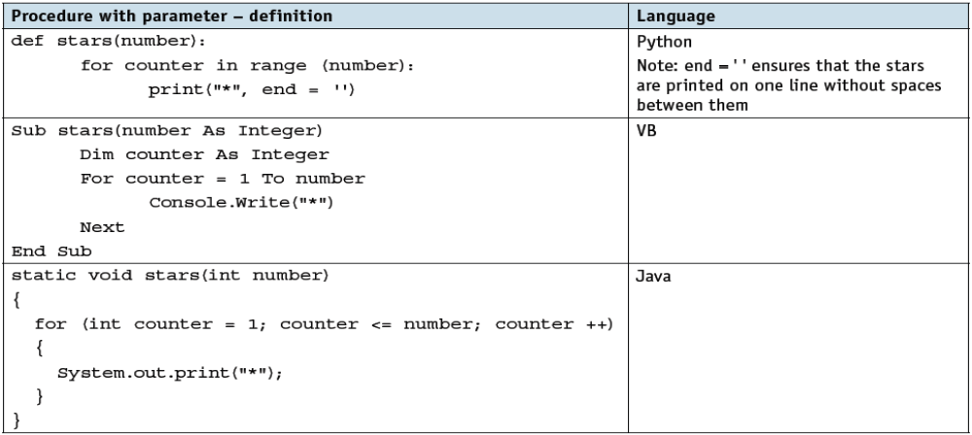
Structured Programming
Procedures
The table below shows how to define a procedure with a parameter in each of the three programming languages.

Slide 22
Structured Programming
Procedures
There are two methods of passing a parameter to a procedure:
  by value
  by reference.
When a parameter is passed by value, if a variable is used, the value of that variable cannot be changed within the procedure.
When a parameter is passed by reference the value of the variable passed as the parameter can be changed by the procedure.

Slide 23
Structured Programming
Procedures
A procedure with parameters passed by reference can be defined in pseudocode as follows:
For example, a procedure to convert a temperature from Fahrenheit to Celsius could be defined as follows:
And used as follows:
PROCEDURE <identifier> (BYREF <parameter1>:<datatype>,
<parameter2>:<datatype>...)
<statements>
ENDPROCEDURE
PROCEDURE celsius(BYREF temperature : REAL)
temperature ← (temperature – 32) / 1.8
ENDPROCEDURE
CALL celsius(myTemp)

Slide 24
Structured Programming
Procedures
The table below shows how to pass parameters in the three programming languages.:
Passing Parameters | Language
Def celsius(temperature): | Python all data is passed by value
Sub celsius(temperature As Decimal) Sub celsius(ByVal temperature As Decimal) Sub celsius(ByRef temperature As Decimal) | VB parameter passed implicitly by value parameter passed by value parameter passed by reference
static void celsius(double temperature) | Java all data is passed by value

Slide 25
Structured Programming
Functions
When writing an algorithm, there are often similar calculations or tasks to perform that make use of the same groups of statements and always produce an answer.
Instead of repeating these statements every time they are required, many programming languages make use of subroutines or named functions.
A function always returns a value; it is defined once and can be called many times within a program.

Slide 26
Structured Programming
Functions
A function without parameters is defined in pseudocode as follows:
A function with parameters is defined in pseudocode as follows:
The keyword RETURN is used as one of the statements in a function to specify the value to be returned.
This is usually the last statement in the function definition.
FUNCTION <identifier> RETURNS <data type>
<statements>
ENDFUNCTION
FUNCTION <identifier>(<parameter1>:<datatype>, <parameter2>:<datatype>...)
RETURNS <data type>
<statements>
ENDFUNCTION

Slide 27
Structured Programming
Functions
Functions are used as part of an expression. The value returned by the function is used in the expression.
For example, the procedure used previously to convert a temperature from Fahrenheit to Celsius could be written as a function:
A function with parameters is defined in pseudocode as follows:
The interface between a function and a program must match the function definition.
When a function is defined with parameters, the parameters in the function call must match those in the function definition.
FUNCTION celsius (temperature : REAL) RETURNS REAL
RETURN (temperature – 32) / 1.8
ENDFUNCTION
myTemp ← celsius(myTemp)

Slide 28
Structured Programming
Functions
Functions are used as part of an expression. The value returned by the function is used in the expression.
Function Example | Language
def celsius(temperature): return (temperature - 32) / 1.8 | Python
Function celsius(ByVal temperature As Decimal) As Decimal Return (temperature - 32) / 1.8 End Function | VB
static double celsius(double temperature) { return (temperature - 32) / 1.8; } | Java

Slide 29
Structured Programming
Functions
When procedures and functions are defined, the first statement in the definition is a header, which contains
  » the name of the procedure or function
  » any parameters passed to the procedure or function
  » the type of the return value for a function.
When procedures or functions are called, the parameters or arguments (the values passed to the procedure or function) must be in the same order as the parameters in the declaration header and each argument must be of the same type as the parameter given in the header.

